Slide 1

Windows PowerShell
System administration and automation in a Windows environment
- Fun facts – out loud -
Karin De Maertelaere, Jochen Mariën

Slide 2
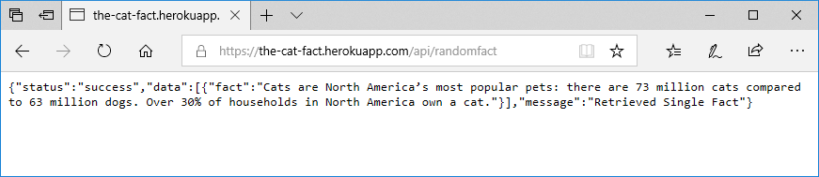
There is a website…
That lists a random cat-fact every time you open it
And it lists the fact in json-format

Slide 3
There are more websites
Cats: https://the-cat-fact.herokuapp.com/api/randomfact
Dogs: https://dog-api.kinduff.com/api/facts
Giraffes: http://www.randomgiraffefacts.com/index.cgi
Note: not json
Chuck Norris: https://api.chucknorris.io/jokes/random

Slide 4
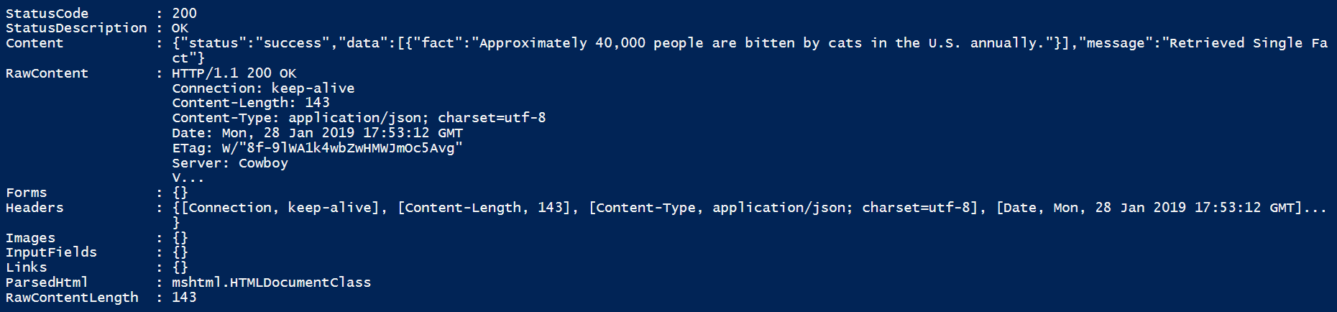
WebRequest
A WebRequest is a request for a website
You invoke it
It returns a website
Invoke-WebRequest -Uri 'https://the-cat-fact.herokuapp.com/api/randomfact'

Slide 5

WebRequest
We only need the catfact, and know that the website is in json format
Result:
So there’s an array, and it contains a fact…
ConvertFrom-Json (Invoke-WebRequest -Uri 'https://the-cat...fact'))
$content = ConvertFrom-Json (Invoke-WebRequest -Uri 'https://the-cat...fact')
$content.data.fact

Slide 6
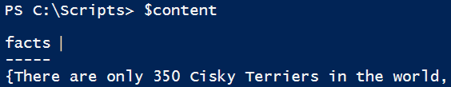

Json
Json is a general data format (mostly seen in API-returns and configurations, not for large amounts of data)
The content of a json-file isn’t set, it can contain anything as long as it’s in the correct general form
So when we try the above code with the dog-url:
But…
$content = C…n (I…t -Uri 'https://dog-api.kinduff.com/api/facts')
$content.data.fact

Slide 7
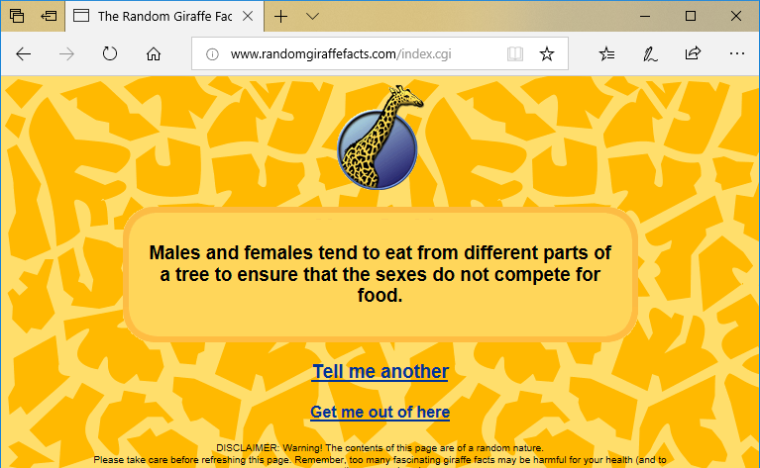
HTML
Figuring out Chuck Norris should be doable now, but Giraffes:

Slide 8
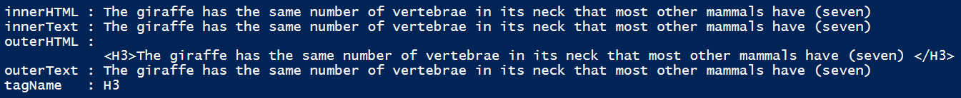
HTML
Getting data from HTML is a process known as screen scraping
In some cases it’s not allowed, in others it’s fine
Screen scraping is usually done in Python or Perl using regular expressions or specialised libraries
But PowerShell is pretty good at it too, because it has a good object
And what helps is that the giraffe-fact is the first element in H3-tags:
$content = Invoke-WebRequest -Uri 'http://www.randomgiraffefacts.com/index.cgi'
$content.AllElements | Where-Object tagname -eq "H3" | Select-Object -First 1

Slide 9
Combining
So now you have four different ways of getting a fact
How to select which one you’ll be getting? Switch
A switch is a programmatical structure that switches based on a value

Slide 10
Switch
$i=22
Switch ($i)
{
1 {“one”}
5 {“five”}
10 {“ten”}
default {“something else”}
}
$fruit = "date"
switch -wildcard ($fruit)
{
"a*" {"An apple"}
"b*" {"A banana"}
"d*" {"A date"}
“c*" {"Cherries"}
“f*" {"A fig"}
default {“Strange type of fruit"}
}
$symbol = "?"
switch -wildcard ($symbol)
{
"[a-z]" {"A letter"}
"[0-9]" {"A number"}
"[,;:.!?]" {"A punctuation mark"}
default {"Unknown symbol"}
}
$sentence = "Microsoft Windows PowerShell"
switch -regex ($sentence)
{
"^\w+$" {“One word"}
"^\w+ \w+$" {"Two words"}
"^\w+ \w+ \w+$" {"Three words"}
default {"A lot of words"}
}

Slide 11
Speaking
PowerShell is good at making your computer say stuff
It uses a separate assembly that you have to import first
You could even customize it further…
https://docs.microsoft.com/en-us/dotnet/api/system.speech.synthesis.speechsynthesizer
Add-Type -AssemblyName System.Speech
$SpeechSynth = New-Object System.Speech.Synthesis.SpeechSynthesizer
$SpeechSynth.Speak("Penguins can be really annoying")
$SpeechSynth.Rate = 5
$SpeechSynth.GetInstalledVoices().VoiceInfo.Name
$SpeechSynth.SelectVoice("Microsoft Zira Desktop")

Slide 12
So, to summarize
You can get random facts from the internet
In a string format
You can select one of four to actually download
You can have the computer say any (English) string
And you can set a PowerShell script as logon script
You can set it in a scheduled task to run at a certain time
You can even run it remotely
And incorporate any API you can find

